Slide 1
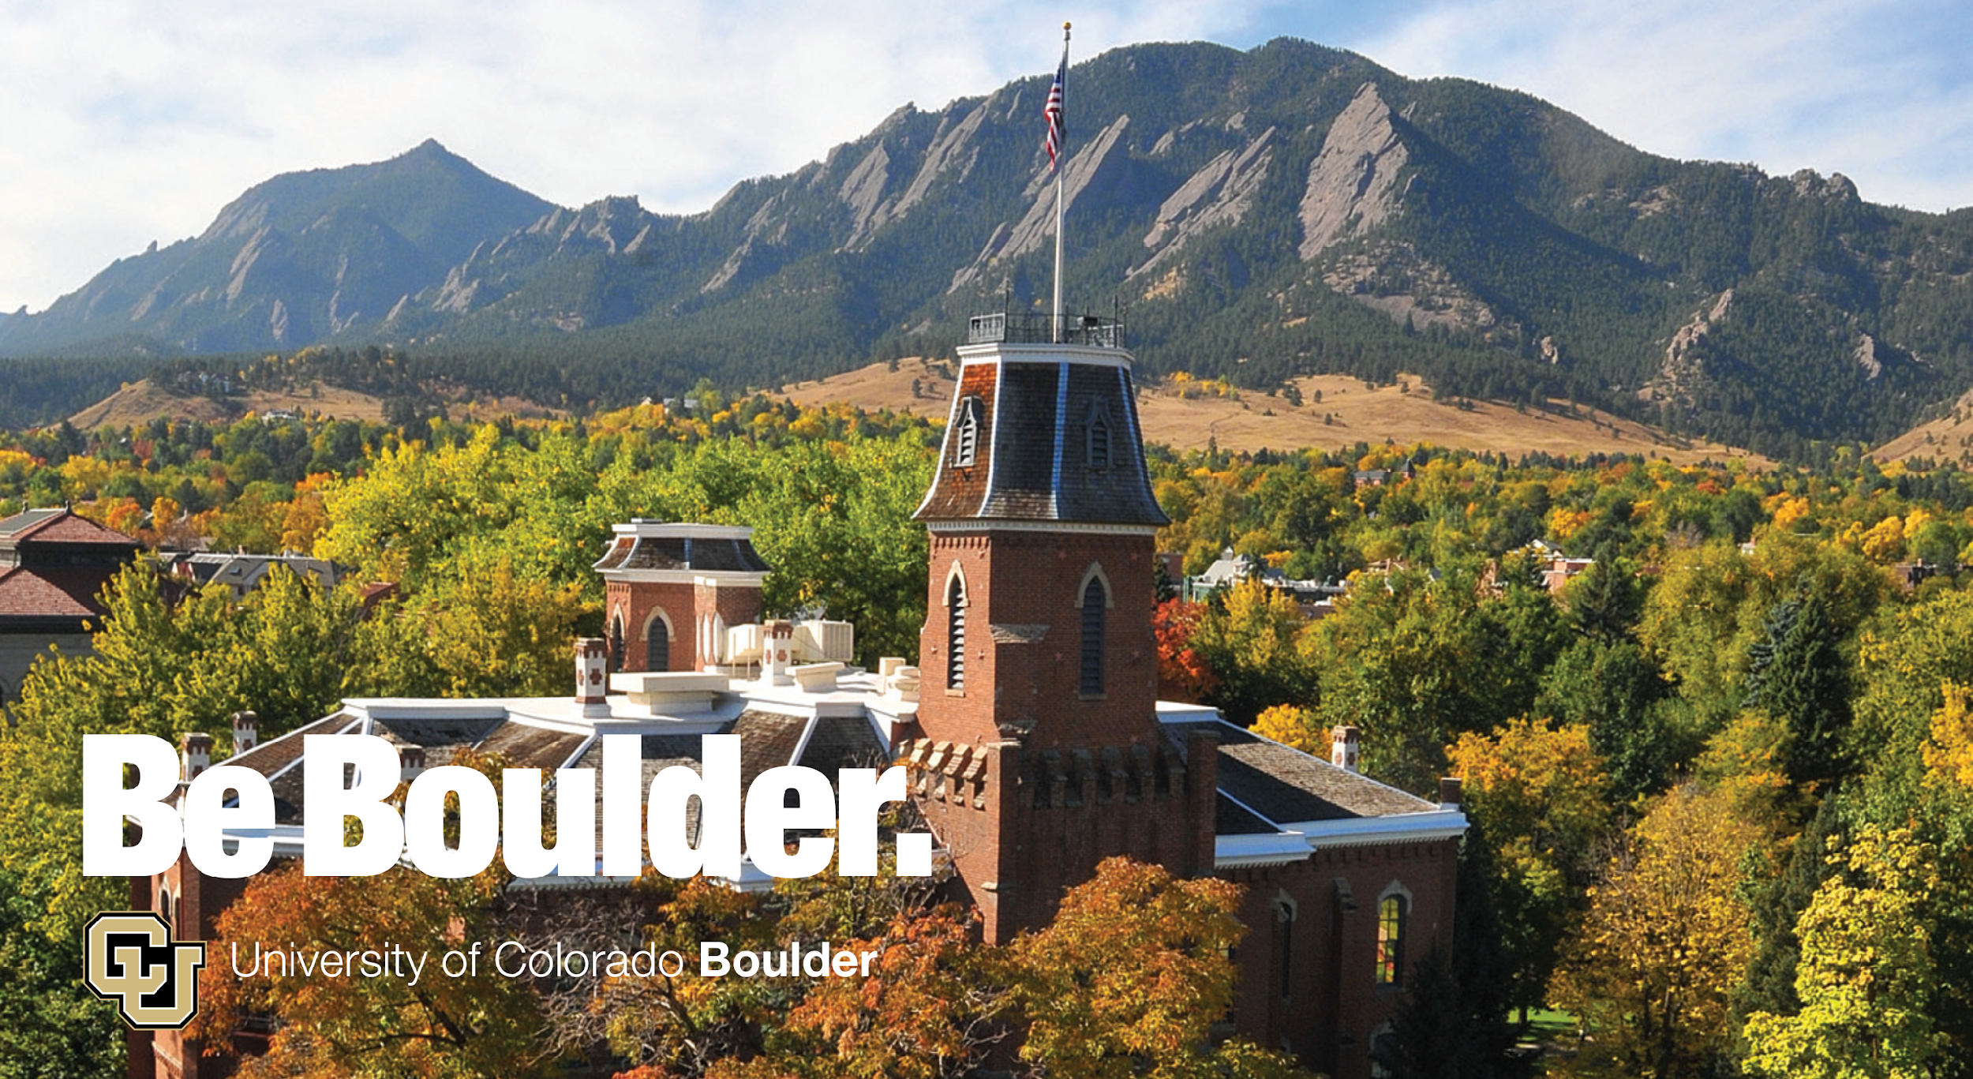
Introduction to Commercial Cloud

Slide 2
Working with Cloud
Mohal Khandelwal
Research Computing
Website: www.rc.colorado.edu
Helpdesk: rc-help@colorado.edu
Dylan Gottlieb
Research Computing
Website: www.rc.colorado.edu
Helpdesk: rc-help@colorado.edu
Slides: https://github.com/ResearchComputing/cloud_primer
Survey: http://tinyurl.com/curc-survey18
Website: www.rc.colorado.edu/rc
Documentation: https://curc.readthedocs.io

Slide 3






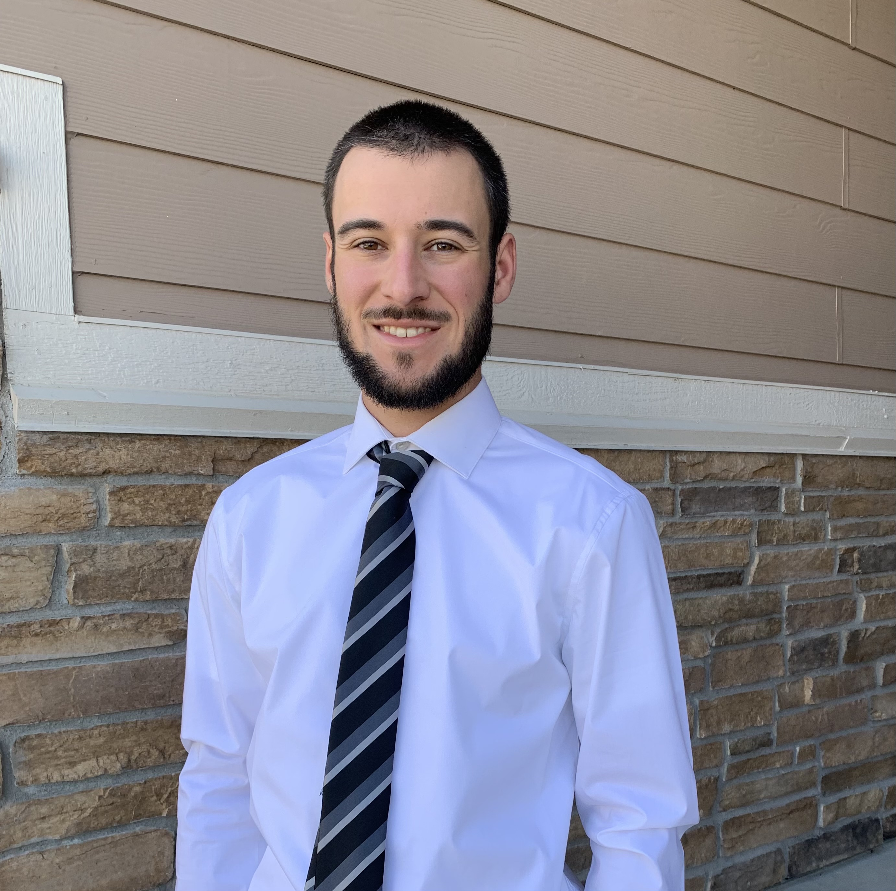


Meet the User Support Team
Layla Freeborn
Brandon Reyes
Andy Monaghan
Michael Schneider
John
Reiland
Dylan Gottlieb
Mohal Khandelwal
Ragan
Lee

Slide 4
Outline
What is the Cloud?
Services offered
Advantages of using the Cloud
Shared Responsibility Model
Example Use-Cases
Cost-Saving Considerations
Live Demo
Learning Materials
How to get started

Slide 5
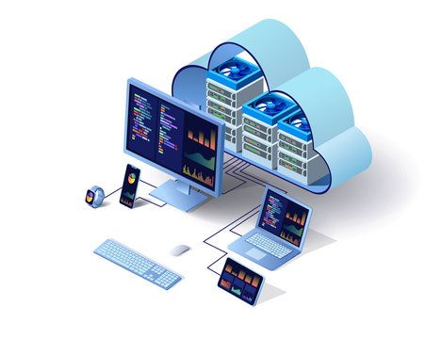
What is the Cloud?
"The cloud" refers to servers that are accessed via the Internet. This includes the Operating Systems, software, and databases that run on those servers.
What is Cloud Computing?
Cloud computing refers to the delivery of computing services over the internet, including storage, processing power, and software applications.

Slide 6


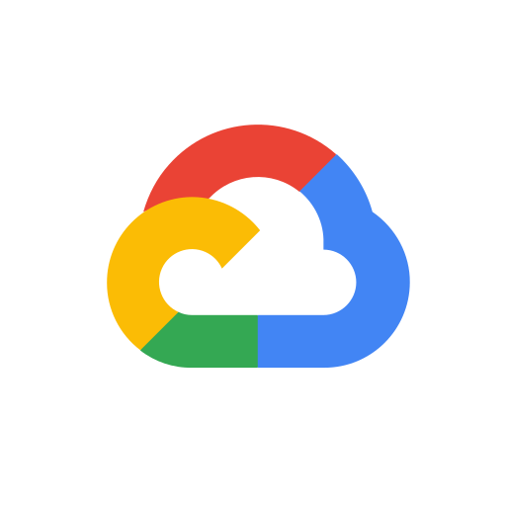
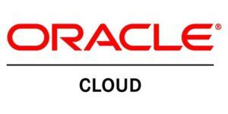

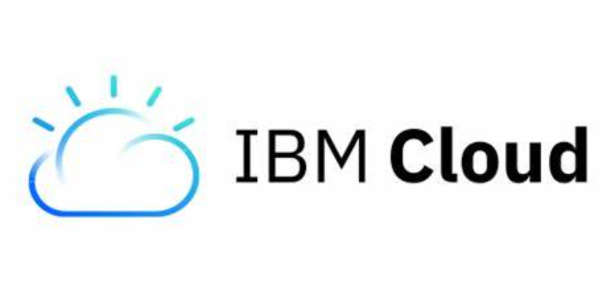

Commercial Cloud Providers
Amazon AWS
Microsoft Azure
Google Cloud Provider
Many more

Slide 7
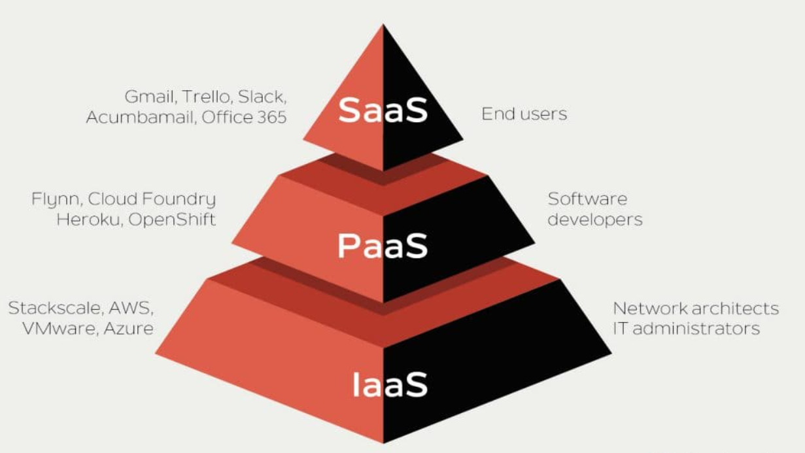
Cloud Service Models
IaaS - Raw IT resources offered to the user by the cloud service provider
Most control, most advanced setup
Servers and Networking
SaaS - Software that runs on a provider’s infrastructure
Least control, most simple setup
Jupyterhub
PaaS - A platform that a provider offers to its customers via the internet
Some control, simplified setup
Windows Virtual Machine

Slide 8
Why use the cloud?
Cost Savings: Pay for what you use, with no upfront infrastructure costs.
Scalability: Easily scale resources up or down based on demand.
Flexibility: Access resources and applications from anywhere with an internet connection.
Reliability: Cloud providers typically offer high uptime and data redundancy.
Collaboration: Enable seamless collaboration and data sharing among teams.

Slide 9
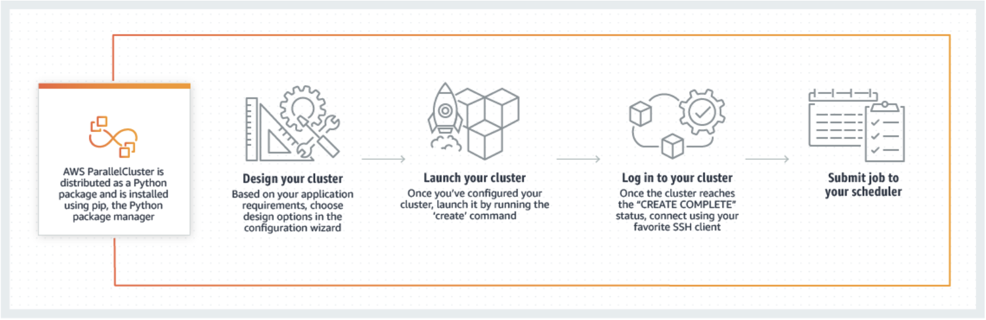
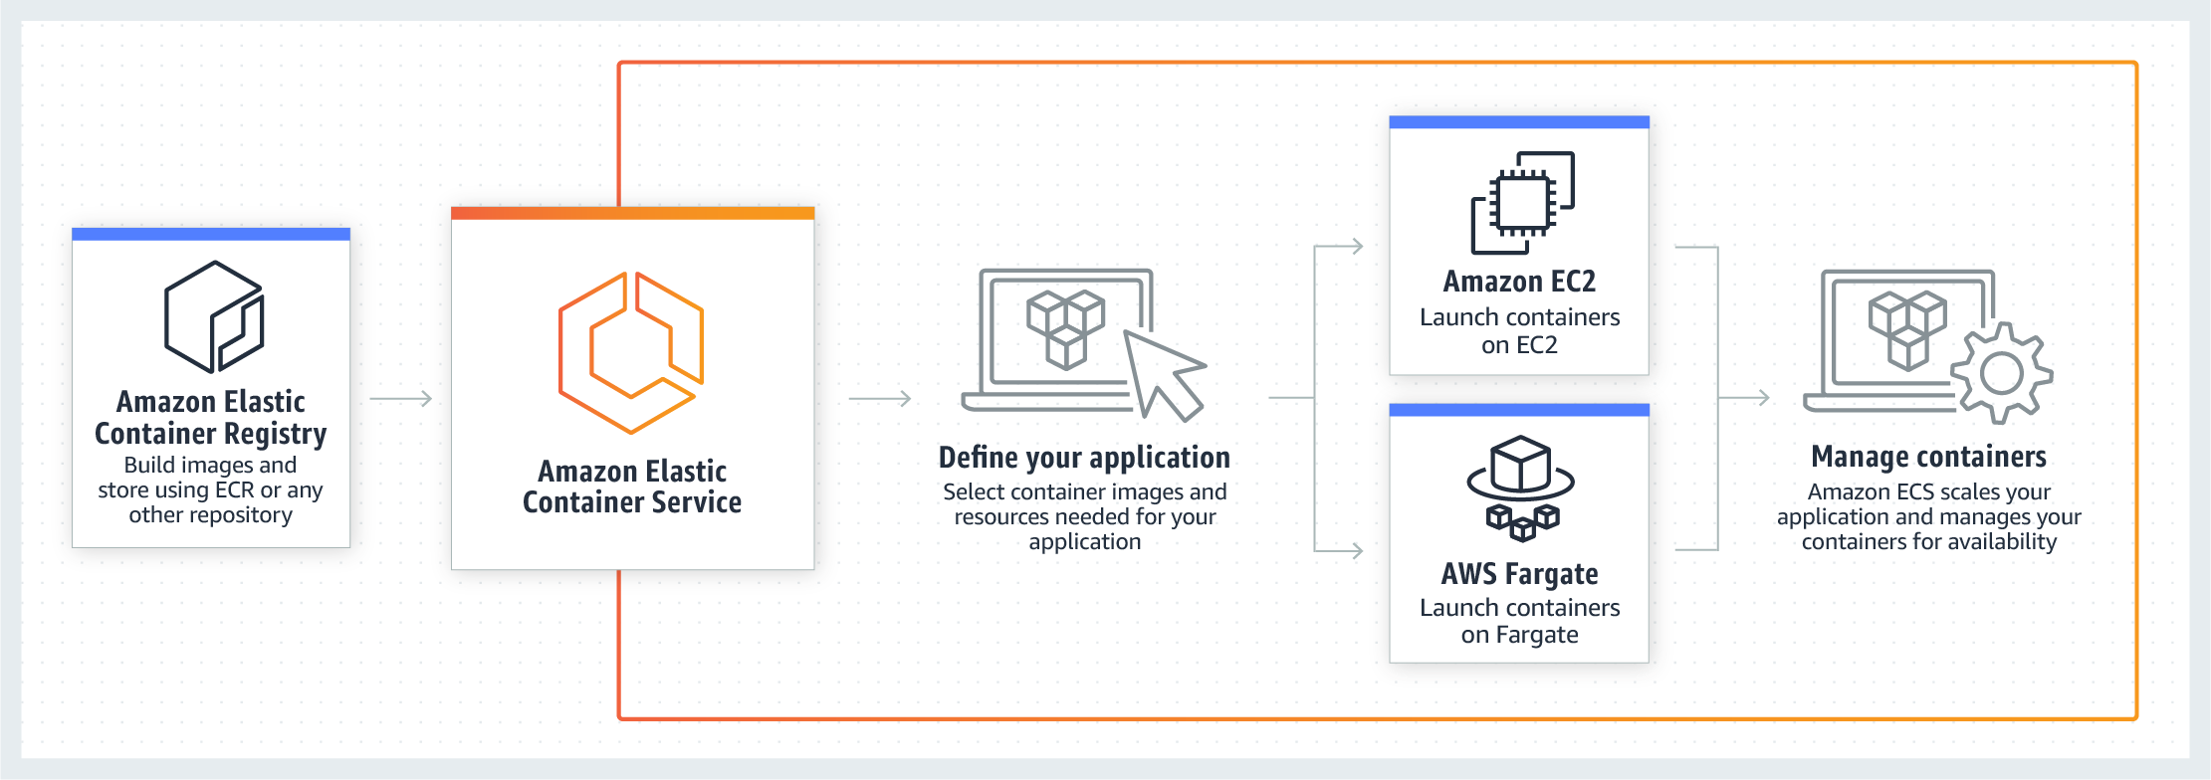
What tools are available?
Parallel Cluster
Advanced Tools
Cluster Environments
Parallel Cluster
Container Services
Elastic Kubernetes Service, Elastic Container Service
Elastic Container Service

Slide 10
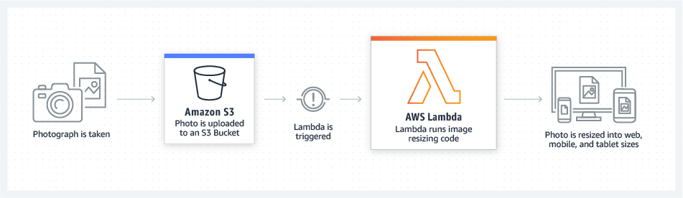
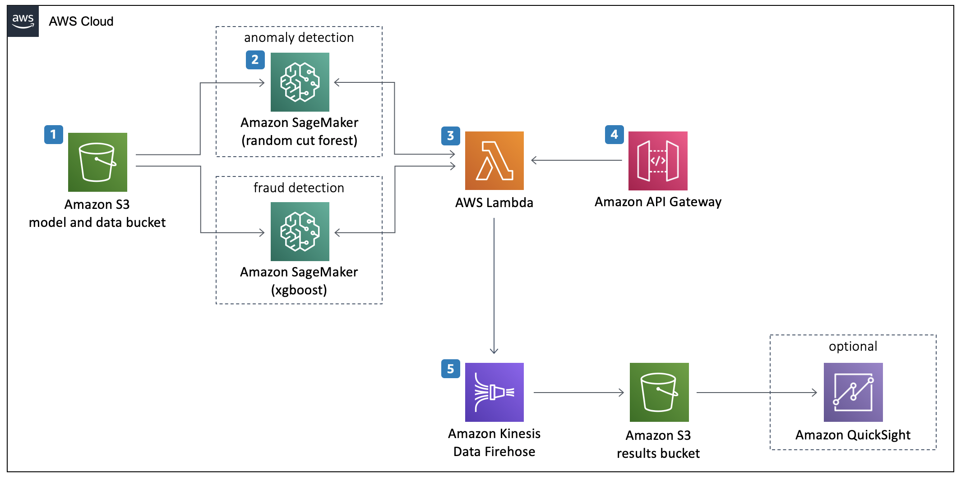
What tools are available?
Lambda
Advanced Tools
Serverless code execution
Lambda
Machine Learning
Sagemaker, Rekognition, Polly, etc.
Artificial Intelligence
Amazon Q, Bedrock, Azure AI Foundry
Sagemaker

Slide 11
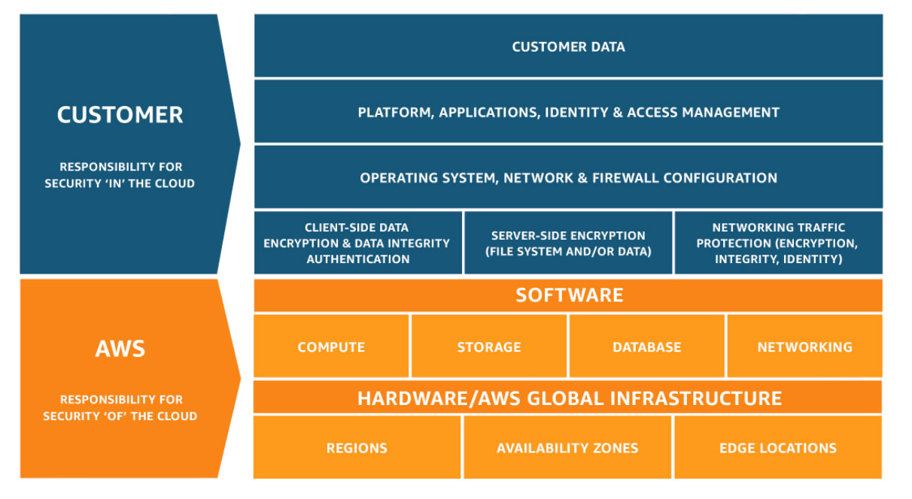
Shared Responsibility Model

Slide 12
Example use-cases
Netflix
Using cloud to meet needs for expensive or otherwise unavailable resources (e.g., specialized GPUs, huge amounts of RAM)
Using cloud computing to be "near" huge bioinformatics or geophysical datasets that are impractical to download (because these huge datasets are often stored in the public cloud)
Teaching "hubs" such as Rstudio and Jupyter, which provide a common software environment for all students

Slide 13

What scares you about working in the cloud?

Slide 14
Cost-Saving Considerations
Budget Alerts and Actions - Alert when budget is reached and shutdown resources
Analyze Cost Data - Understand cost on a resource level
Spot Instances - Utilize cloud provider's unused resources at discount
Reserved Instances - Commitment to use VM for extended period at a discount
Autoscaling - Scale resources as demand grows
Utilizing serverless functions - 1 million requests/month free
Microservices - Separate monolithic applications into smaller pieces
Appropriate Storage Options - Utilize cold storage when applicable

Slide 15

Cloud DEMO
Notes:
http://bit.ly/OIT-AWS

Slide 16
Learning Materials
AWS Educate
Azure Learn
Google Cloud Training

Slide 17
Cloud Resources
AWS
Free Trials offered by AWS
AWS Free Tier
Azure
Microsoft Student
Free $100 credit for students
Free trials of services
GCP
Google Free Tier
Free trials of services

Slide 18
How to get started
Reach out to the Cloud Foundations Service at CU
https://www.colorado.edu/rc/userservices/contact
National Science Foundation – JetStream2
Cloud Foundations Service
Amazon AWS
Microsoft Azure
Google Cloud Platform
Notes:
We'll help to provision the resources you need, estimate costs for these resources.
We'll work with you on budgeting.

Slide 19
Cloud Foundations Service
What we Offer
Basic Security Guardrails
Billing against CU funds (Purchase Order / Speedtype)
Connection to internal CU network
Federated Access
Support & Consulting
Notes:
Can communicate within the internal CU network
Federated Access (identikey)
Billing
Security, etc

Slide 20

Survey and feedback
Survey: http://tinyurl.com/curc-survey18
Slides: https://github.com/ResearchComputing/cloud101_primer

